Slide 1
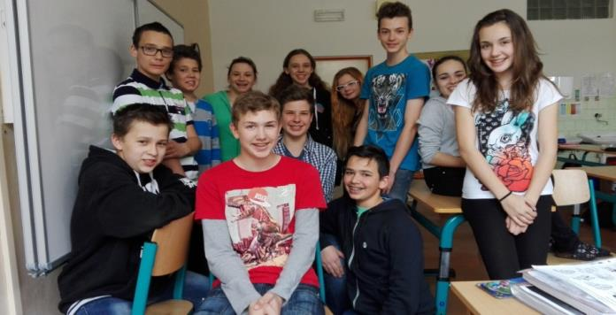
Our school, town, the Czech Republic prepared by 7.C
THERE´S NO PLACE LIKE HOME

Slide 2
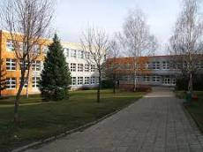
OUR SCHOOL
THERE´S NO PLACE LIKE HOME
Our school consists of over 300 students. The school is located in the Staré Město near the Neighborhood Kopánky. The school provides several after –school activites, for example :floorball, softball, volleyball, Experiments with Physics, Ready for Life( learning English), Iguana – keeping pets, Play with Math and IT Robots.
We also have school Eco- School that cares about the environment of the school. We must not forget the school parliament, which make decisions about various important matters.

Slide 3
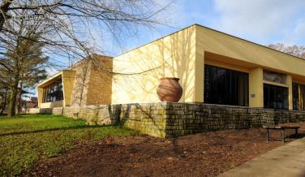
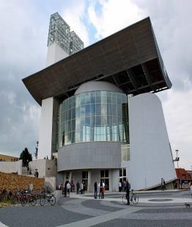
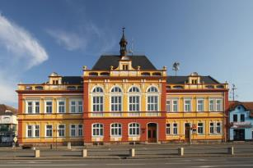
THERE´S NO PLACE LIKE HOME
Our Town
There is a heart of Moravian Empire and
a famous museum is located here.
There are two churches,
We have a new modern church,
which was a hard and long construction.

Slide 4
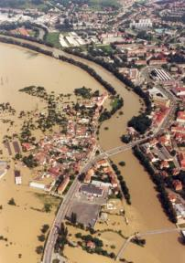
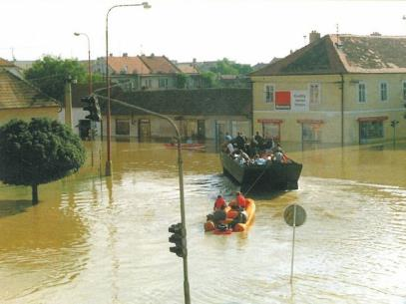
FLOODS in 1997
THERE´S NO PLACE LIKE HOME
Our town was hit and flooded by a big wave from the Morava river.

Slide 5
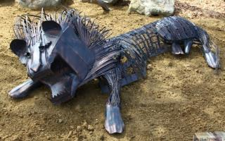
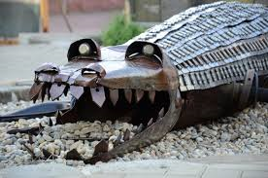
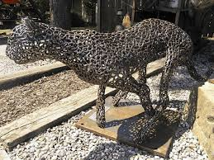
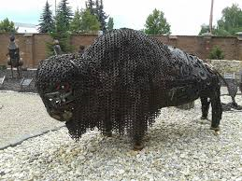
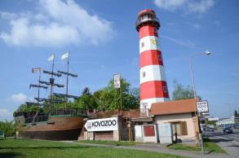
KOVO ZOO -metal zoo exhibition in our town - the only one in EUROPE
THERE´S NO PLACE LIKE HOME

Slide 6
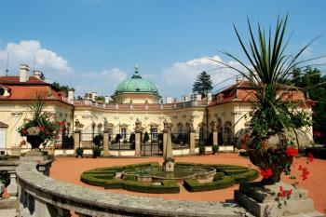
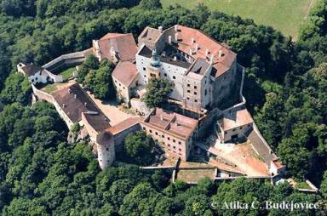
Buchlovice chateau and Buchlov castle
THERE´S NO PLACE LIKE HOME
The most beautiful places of interest in South Moravia

Slide 7
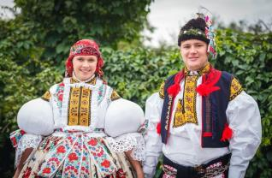
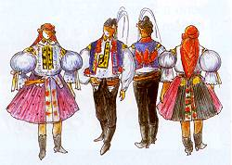
THERE´S NO PLACE LIKE HOME
The most striking areas of culture in the Staré Město is folklore.
This company has a long tradition of Staré Město , our popular folklore ensemble is called Dolina
The members of this folklore group keep these traditional customs, thanks to the ensemble, these traditions are still part of our town.
The traditional customs is an annual Michael's folklore feast festival.
It is held each September on the occasion of the feast of St. Michael, who is the saint patron of the town.
Feasts are one of the most visited events.
Folk costumes in Staré Město.

Slide 8
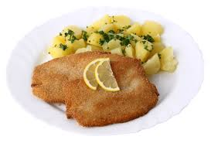
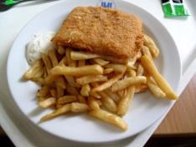
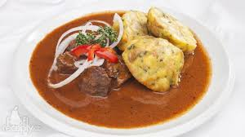
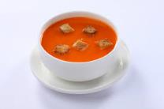
Dobrou chuť Enjoy your meal!
THERE´S NO PLACE LIKE HOME
For Czech food is typical souce,fatty meat,lot of species of pastry ,pie and soups. Typical Czech food:
Schnitzel Fried cheese Tomato soup
Goulash

Slide 9
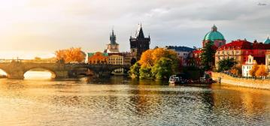
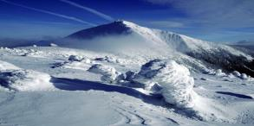
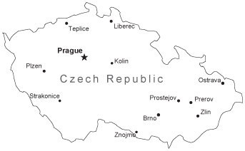
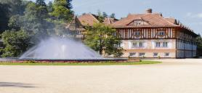
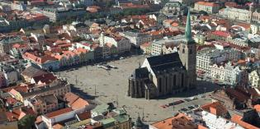
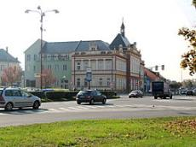
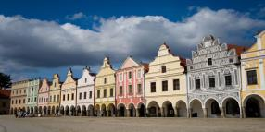
THERE´S NO PLACE LIKE HOME
SNĚŽKA
(mount)
LUHAČOVICE SPA
TELČ
STARÉ MĚSTO

Slide 10
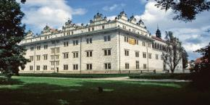
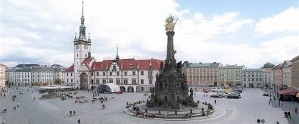
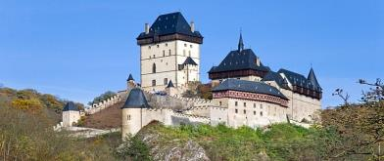
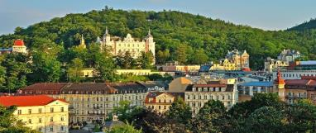
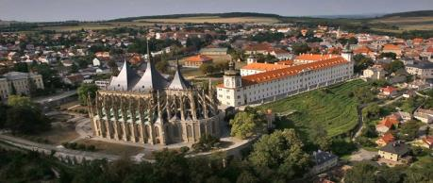
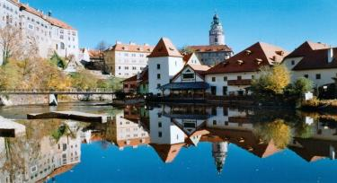
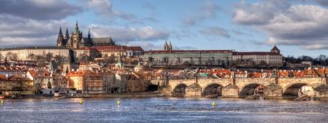
THERE´S NO PLACE LIKE HOME
8.
TOP 10 OF CZECH REPUBLIC
•10.- Plzeň
•9.- Moravian Karst
•8.- Litomyšl
•7.- Olomouc
•6.- Telč
•5.- Castle Karlstejn
•4.- Karlovy Vary
•3.- Kutna Hora
•2.- Český Krumlov
•1.- Prague
7.
5.
4.
.
3.
2.
1.

Slide 11
THERE´S NO PLACE LIKE HOME
English: Czech:
Hello Ahoj
Goodbye Nashledanou
Goog morning Dobré ráno
Good afternoon Dobré odpoledne
Good evening Dobrý večer
Good night Dobrou noc
I love you Miluju Tě
I like it Líbí se mi to
Schnitzel Řízek
please prosím
Okay, now something harder to pronounce:
Beet Řepa
River Řeka
Watercress Řeřicha
Rattlesnake Chřestýš

Slide 12
THANK YOU
For your time and attention!
Please come to see us soon...

