Slide 1
Czech Easter traditions

Slide 2
Easter egg
Easter egg is a blown egg, decorated varied art techniques. Since the early Christianity are Easter eggs symbol of fertility and rebirth.
In the Eastern tradition, eggs are red and symbolize the blood of Christ.

Slide 3
Easter lamb
Easter lamb is a kind of sweet pastry, which is prepares traditionally at Easter, shaped like lying lamb. It is formed of a sweet dough, which sometimes includes sweet gelatinous pieces or fruits like raisins. In some cases it can be soaked in chocolate or glaze.

Slide 4
Easter bunny
It usually symbolizes happiness, as well as time that is measured by life.
However, the present Easter Bunny has a clear mission. It brings children eggs, in best chocolate. The bunny-carrier tradition has penetrated us from Germany and over time, the figure of the bunny becomes more and more popular.

Slide 5
Feasting
On Easter Monday morning, men and boys walk around their friends' homes, whipping women and girls by handmade willow wicker. The whip is made up of twenty-four twigs and is usually from half to two meters long and decorated with a knitted handle and colored ribbons. By tradition is still kept, that girls not dry. Men says carols during feasting. The most popular carol is: „Hody, hody doprovody, dejte vejce malovaný, nedáte-li malovaný, dejte aspoň bílý, slepička vám snese jiný…” For return, girls give them a ribbon and a Easter egg.

Slide 6
Worship
For Christians, Easter is the most expected year. They are connected with the resurrection of Jesus Christ.

Slide 7
Days during the Easter

Slide 8
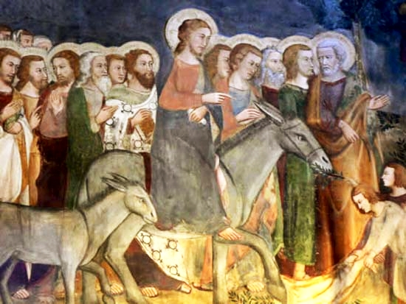
Palm Sunday
This day we celibrate Christ's entrance to Jerusalem.

Slide 9
Blue Monday
Blue Monday is the final carnival day. The churches were decorated by blue and purple cloth. From here also comes the name Blue Monday. This day wasn´t allowed to work.

Slide 10
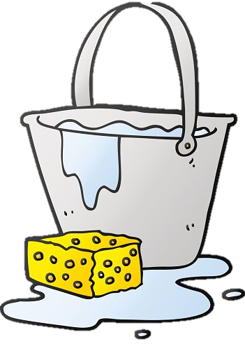
Gray Tuesday
This day was intended to clean the house. On this day, cobwebs should be swept out of the house. In many houses were cleaned windows or even bleached.

Slide 11
Ash Wednesday
Name Ash Wednesday comes from the chimneys were sweeping this day. By folk superstition, on this day people should not frown, because they will frown on all Wednesdays in the next year.
On this day Judas frowned at Jesus.

Slide 12
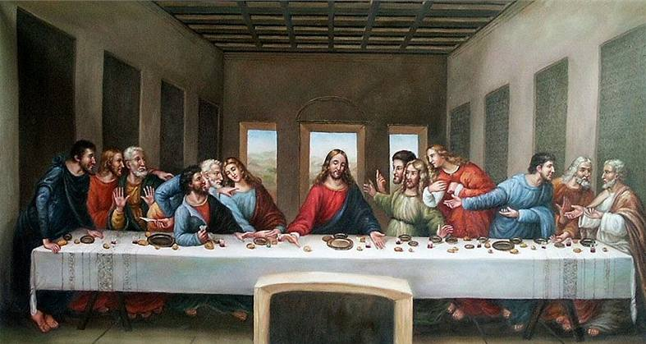
Green Thursday
By the superstition, a green food (spinach, cabbage, pea,..) was eaten on this day to be healthy through the whole year.
At Gloria on Green Thursday, bells and organs will sound for the last time until the Easter Vigil. This tradition is called „odlet zvonů do Říma“.
This day is remark on the Last dinner.

Slide 13
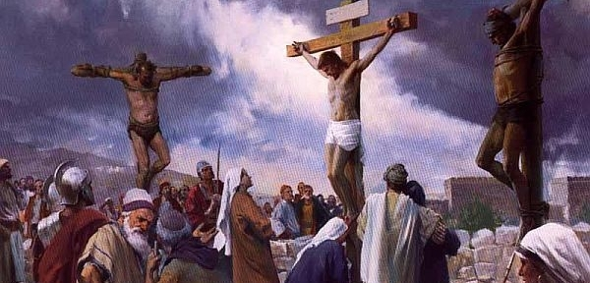
Good Friday
Good Friday, day of the Christs crucifixion, is in folk superstition connected with magical powers. In this day mountains should open, which give own treasures.
In this day wasn´t allowed lend things (thing should be enchanted), move with a ground (engrave, dig, hoe) or wash clothes, because it would be soaked in Christ's blood.

Slide 14
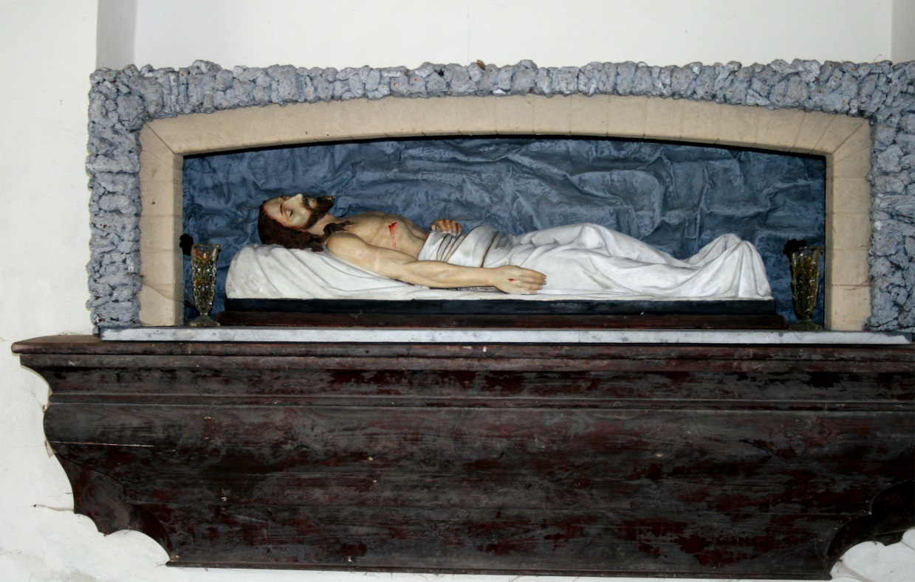
White Saturday
Recalls day when Christ lay in the grave.
During day are not making rites or holy masses.
On White Saturday finish lent.

Slide 15
Easter Sunday
The Lord's Resurrection is the greatest celebration of the Christian Church Year, in which Christ's resurrection and victory over death (and the redemption of all mankind) are celebrated.

Slide 16
Resources
https://www.pastorace.cz/tematicke-texty/svaty-tyden-kraticky-pruvodce
https://cs.wikipedia.org/wiki/Svat%C3%BD_t%C3%BDden
https://eurozpravy.cz/domaci/zivot/187290-ceske-velikonocni-tradice-dodrzujete-je/
https://www.lepebydlet.cz/poznejte-velikonocni-tradice-modre-pondeli

Slide 17
End. Thank you for your attention
Developed : Denisa Pavlicová

